Slide 1
Intersection & Resection
Intersection and resection are surveying methods used to take measurements for determining the coordinates of unknown points from known points and vice versa.
Measurements may be angles only or lengths only or both kinds of measurements.

Slide 2
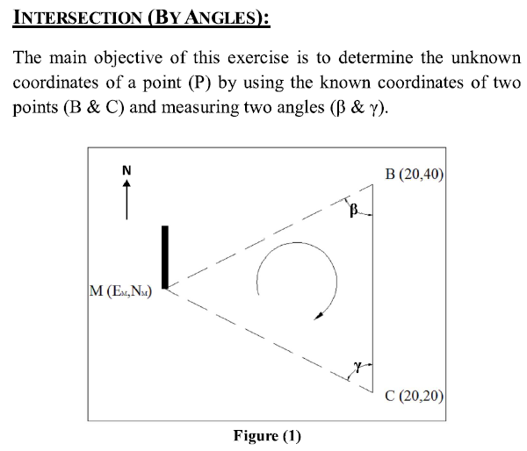
M

Slide 3
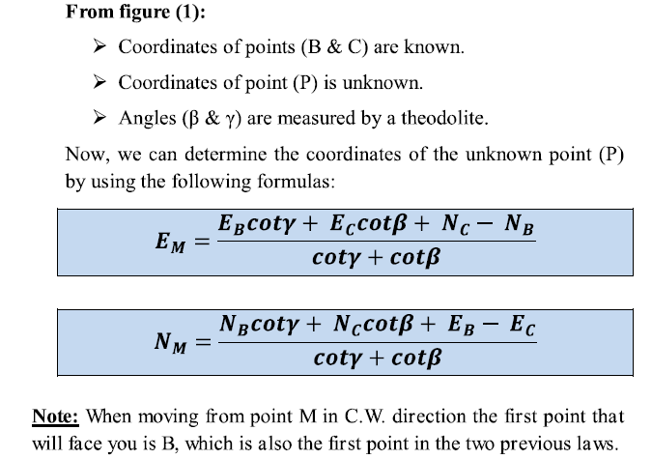
M
M

Slide 4
